Slide 1





Realistic Laue cameras
- using advanced McStas keywords and a look at polycrystal-samples

Slide 2


Agenda
Polycrystals - how to describe them?
Combining a powder sample with a Single Crystal
Tricking the Single_crystal…
A reminder of the GROUP and SPLIT keywords
The dangerous JUMP keyword
A at look at the TOPAZ and SENJU instruments

Slide 3
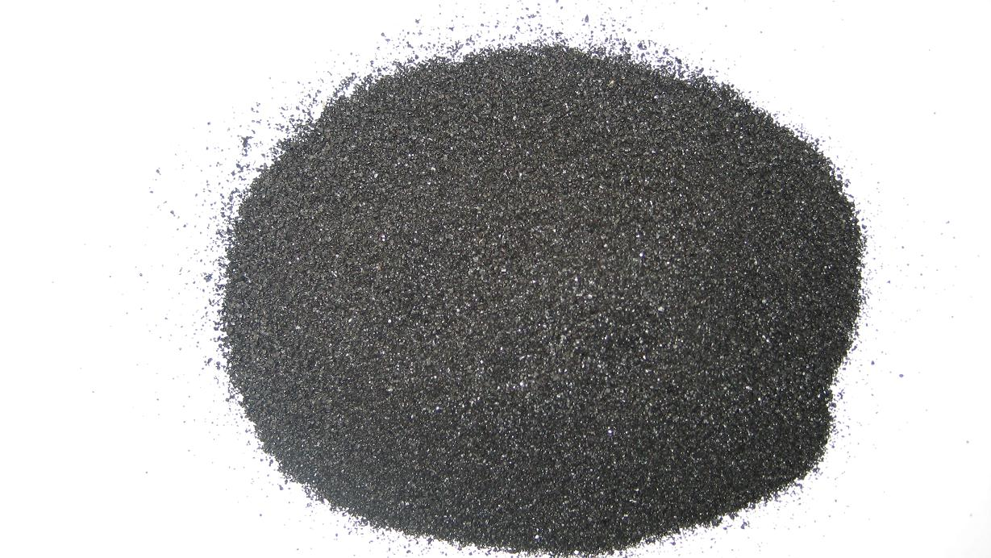
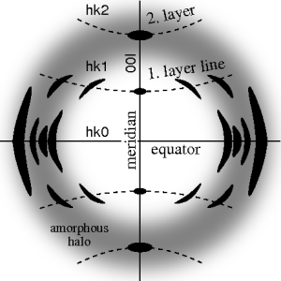
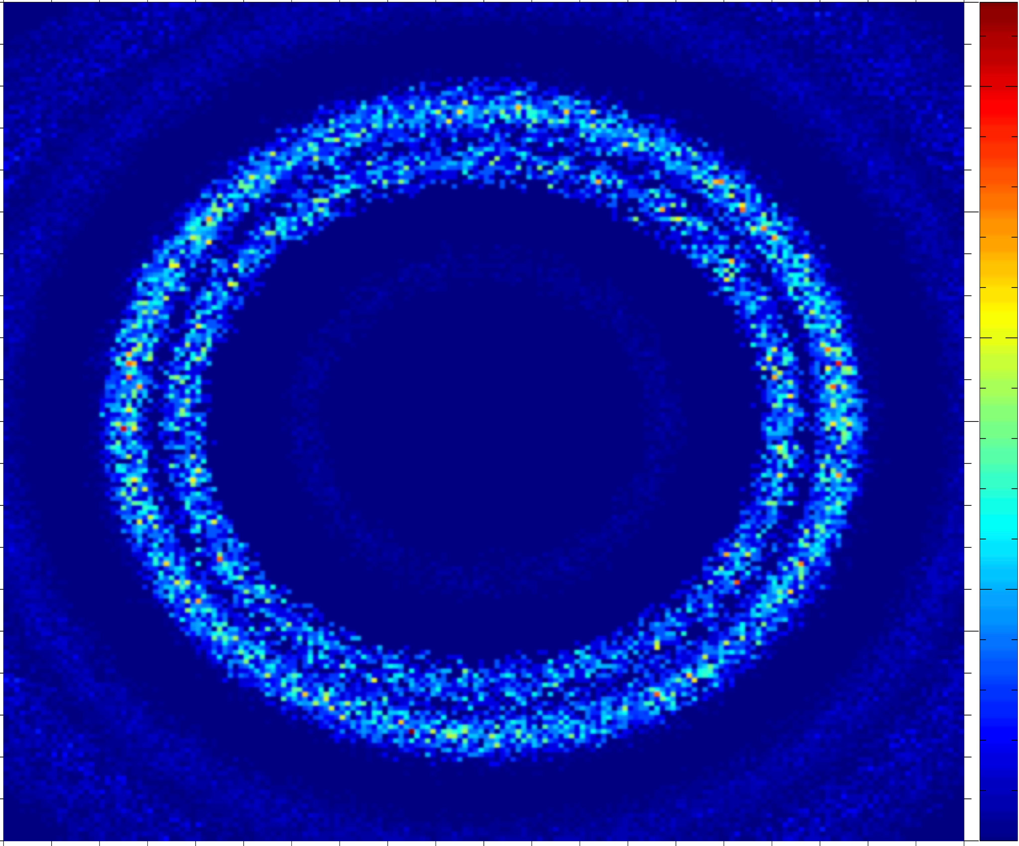

From single crystal / crystallites to powder….
Single crystal
Polycrystal with a little disorder, i.e. a preferred orientation, texture
Powder with complete disorder

Slide 4
Powder SX combination
Use a GROUP!
… but also allow reentry – How?
COMPONENT a1 = Arm()
AT(0,0,0) RELATIVE sample_pos
EXTEND
%{
sample_scatter=0;
%}
COMPONENT pow = PowderN( … )
AT(0,h/2,0) RELATIVE a1
GROUP sample
EXTEND
%{
if(SCATTERED) sample_scatter=1;
%}
COMPONENT sx = Single_crystal( …)
AT(0,-h/2,0) RELATIVE a1
GROUP sample
EXTEND
%{
if(SCATTERED) sample_scatter=1;
%}
COMPONENT a2 = Arm()
AT (0,0,0) RELATIVE a1
WHEN (scatter) JUMP a1
Powder
Single Crystal

Slide 5
Extending that idea
A polycrystal as many Single crystals
The idea: Cheat a single Single_crystal into believing it is many...

Slide 6
Apply translation

Slide 7
Single_crystal as polycrystal
Scattering events happen in the crystal neutron exits.
Apply translation

Slide 8
Single_crystal as polycrystal
Apply inverse translation
Scattering events happen in the crystal neutron exits.
Apply translation

Slide 9
Single_crystal as polycrystal
Apply inverse translation
Neutron may enter a new subcrystal...
Scattering events happen in the crystal neutron exits.
Apply translation

Slide 10
SPLIT
Increase statistics beyond this point in the instrumentfile
SPLIT n MyArm = Arm()
AT somewhere
will “formulate an if-statement”:
for j=1:n
comp1
comp2
comp3
...
end (of instrument)
ONLY meaningful in case of Monte Carlo choices after SPLIT point...

Slide 11
SPLIT
Increase statistics beyond this point in the instrumentfile
SPLIT n MyArm = Arm()
AT somewhere
will “formulate an if-statement”:
for j=1:n
comp1
comp2
comp3
...
end (of instrument)
ONLY meaningful in case of Monte Carlo choices after SPLIT point...

Slide 12
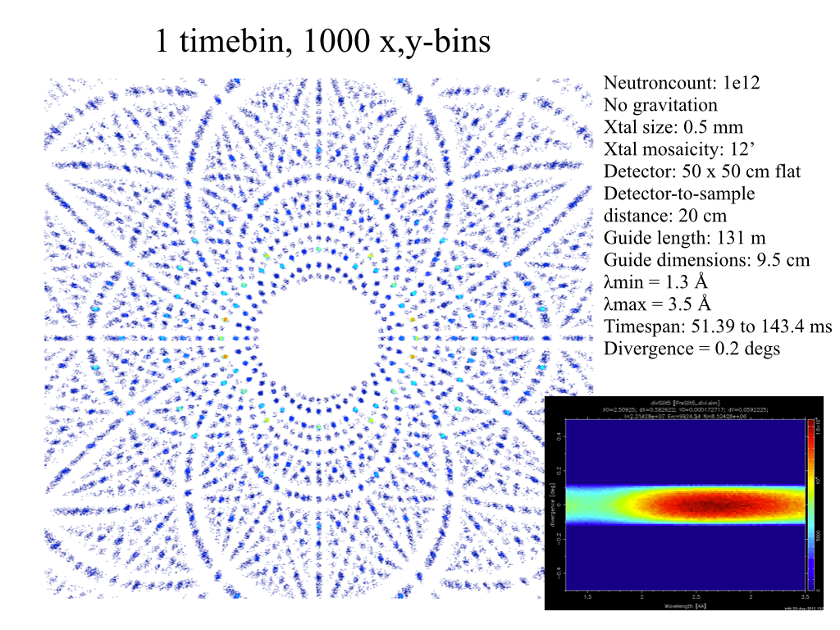
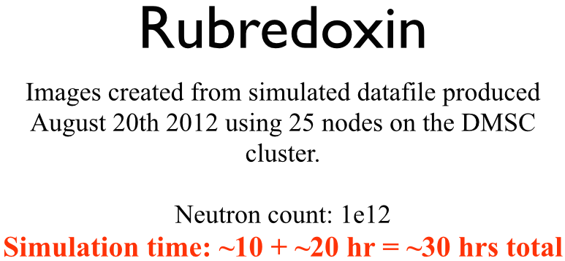
Problem: McStas Single_crystal.comp “slow” for large unit cell diffraction studies
slight sidetrack….
Example: Rubredoxin
Reflection list ~ 124 K reflections (still “small” in the PX world!!)

Slide 13
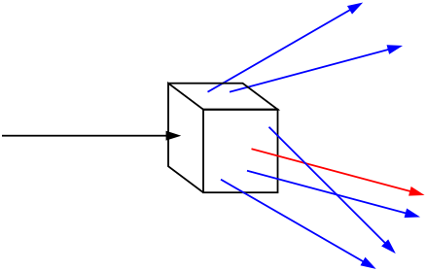
Algorithm improvement: Use incoming neutrons more efficiently - scatter each one on all possible reflections
slight sidetrack….
Red: Original algorithm, one incoming neutron used only once
Blue: Improved algorithm, each incoming neutron scattered (via SPLIT keyword) all possible times
Component makes estimate on average number of “active” diffraction spots - in the case Rubredoxin this is around 50!

Slide 14

GROUP - components working in parallel
COMPONENT Mono1 = Monochromator_curved(...)
AT (0,0,-LMM) RELATIVE Cradle ROTATED (0,A1/2,0) RELATIVE Cradle
GROUP IN6Monoks
COMPONENT Mono2 = Monochromator_curved(...)
AT (0,0,0) RELATIVE Cradle ROTATED (0,A2/2,0) RELATIVE Cradle
GROUP IN6Monoks
- One comp after the other is “tried” in sequential order until the neutron was SCATTERED.

Slide 15
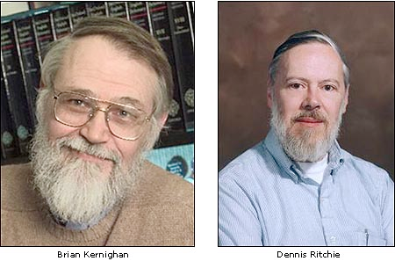

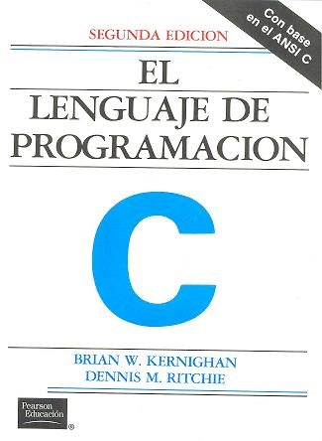
EXTEND
Enrich component behaviour using EXTEND:
COMPONENT Mono1 = Monochromator_curved(...)
AT (0,0, -LMM) RELATIVE Cradle ROTATED (0,A1/2,0) RELATIVE Cradle
GROUP IN6Monoks
EXTEND
%{
if (SCATTERED) { myvar = 1; }
%}
...
COMPONENT Mono2 = Monochromator_curved(...)
AT (0,0, 0) RELATIVE Cradle ROTATED (0,A2/2,0) RELATIVE Cradle
GROUP IN6Monoks
%{
if (SCATTERED) { myvar = 2 ;}
%}
K & R. / GNU

Slide 16

WHEN
Syntax:
COMPONENT Mine = Yours(blah, blah)
WHEN (c-expression) AT (....)
Is very powerful when combined with EXTEND and user variables, or as a method to let input parameters select if certain components are active.
Example: Use EXTEND to flag if neutron was scattered on one monochromator blade or another. Then later use WHEN to only show contribution from blade N at sample position?
COMPONENT Mon = PSD_monitor(...)
WHEN (myvar==1) AT (0,0,0) RELATIVE Sample
K & R. / GNU

Slide 17
JUMP
A goto. Be careful. Can be used in two situations:
JUMP to myself
JUMP to an Arm
No coordinate transformations are applied... (Meaning that if the Arms you JUMP between do not coincide you will “move” / “reorient” the neutrons...)
Syntaxes:
COMPONENT a=b(...)
WHEN (expr) AT (...) JUMP somewhere
COMPONENT a=b(...)
WHEN (expr) AT (...) JUMP myself
Van Halen...

Slide 18
JUMP
A goto. Be careful. Can be used in two situations:
JUMP to myself
JUMP to an Arm
No coordinate transformations are applied... (Meaning that if the Arms you JUMP between do not coincide you will “move” / “reorient” the neutrons...)
Syntaxes:
COMPONENT a=b(...)
WHEN (expr) AT (...) JUMP somewhere
COMPONENT a=b(...)
WHEN (expr) AT (...) JUMP myself
BEWARE - This IS a GOTO!
Van Halen...

Slide 19
JUMP
A goto. Be careful. Can be used in two situations:
JUMP to myself
JUMP to an Arm
No coordinate transformations are applied... (Meaning that if the Arms you JUMP between do not coincide you will “move” / “reorient” the neutrons...)
Syntaxes:
COMPONENT a=b(...)
WHEN (expr) AT (...) JUMP somewhere
COMPONENT a=b(...)
WHEN (expr) AT (...) JUMP somewhere
BEWARE - This IS a GOTO!
Van Halen...

Slide 20
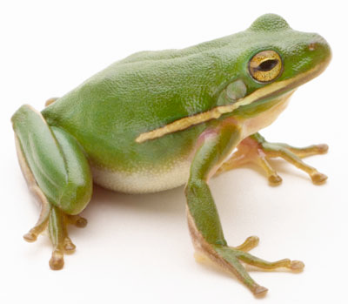
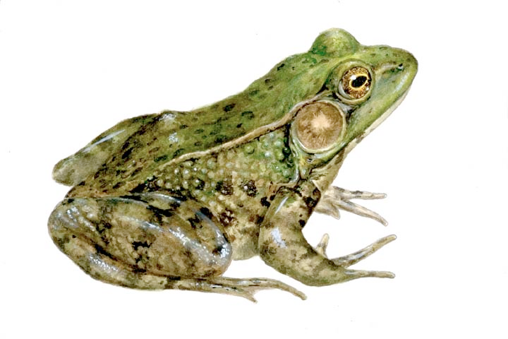
COPY- inside instruments
In instruments: (see ILL_H25.instr)
COMPONENT H25_1 = Guide_gravity(
w1=0.03, h1=0.2, w2=0.03, h2=0.2, l=L_H25_1,
R0=gR0, Qc=gQc, alpha=gAlpha, m=m, W=gW)
AT (0,0,Al_Thickness+gGap) RELATIVE PREVIOUS
ROTATED (0,Rh_H25_1,0) RELATIVE PREVIOUS
COMPONENT COPY(H25_1) = COPY(H25_1)
AT (0,0,L_H25_1+gGap) RELATIVE PREVIOUS
ROTATED (0,Rh_H25_1,0) RELATIVE PREVIOUS
COMPONENT COPY(H25_1) = COPY(H25_1)(W=2*gW)
AT (0,0,L_H25_1+gGap) RELATIVE PREVIOUS
ROTATED (0,Rh_H25_1,0) RELATIVE PREVIOUS

Slide 21
TOPAZ and SENJU
Take a look at a couple of “real” instrument simulations of Laue Cameras:
they both resides in GitHub under today / 3_Laue_diffractometers_TOPAZ\&SENJU/
1. SNS TOPAZ
2. J.PARC SENJU (aka. BL18)
Here you need to also copy a datafile for the J-PARC source “source_BL18.txt”
Surgeon General’s Warning: There are lots of COMPONENTS here

